Slide 1

On Simple Linear Regression
Notes:
Slide 13 presents a task for students: Use the expressions for the betas just presented to find the best-fit line through a set of three points. The remaining slides except the last work through this task. If you want students to work through this, plan on giving them 6-10 minutes for it. The first 12 slides should take 30-40 minutes.

Slide 2
LR is a fundamental tool in the data scientist’s kit.
Practically speaking, using it is one or two lines of code.
But it’s crucial for us to understand the theory underlying it:
Building block for more complex tools
We are better data scientists if we understand both HOW and WHY
Why Linear Regression ?
Notes:
General lesson about sklearn (and statsmodels): Training models will be super easy, but what’s happening under the hood will be more complex.

Slide 3
.Simple Linear Regression.
Simple: functions of a single variable: Y = f(X)
Linear: models are lines
Regression: dependent variable is continuously-valued

Slide 4
.Inference and Prediction.
As population density increases, so do housing prices.
As the number of trees decreases, the concentration of
CO₂ goes up.
Notes:
There are of course a HUGE number of possible examples here. But the basic idea of using one variable (or several) as a sort of proxy for another is what ML is all about, so it’s worth stressing this point. We return at the end of the phase to this issue of inferential vs. predictive statistics. LR is a central topic at FIS both because it’s our entry into ML and because we can engage in it in either a predictive mode (focusing on loss function, test-set performance, etc.) or an inferential mode (focusing on the values of the betas, meeting the assumptions of LR, etc.).

Slide 5
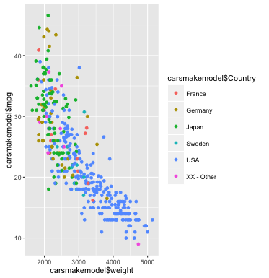
.Car Weight and MPG.
Notes:
This example shows a typical situation: Pretty clear correlation here between weight and MPG. It’s also something less than a perfectly linear relationship, but that’s OK! No model is perfect, and in fact the oversimplification is its strength. (This example comes from coding with the ggplot library in R.)

Slide 6
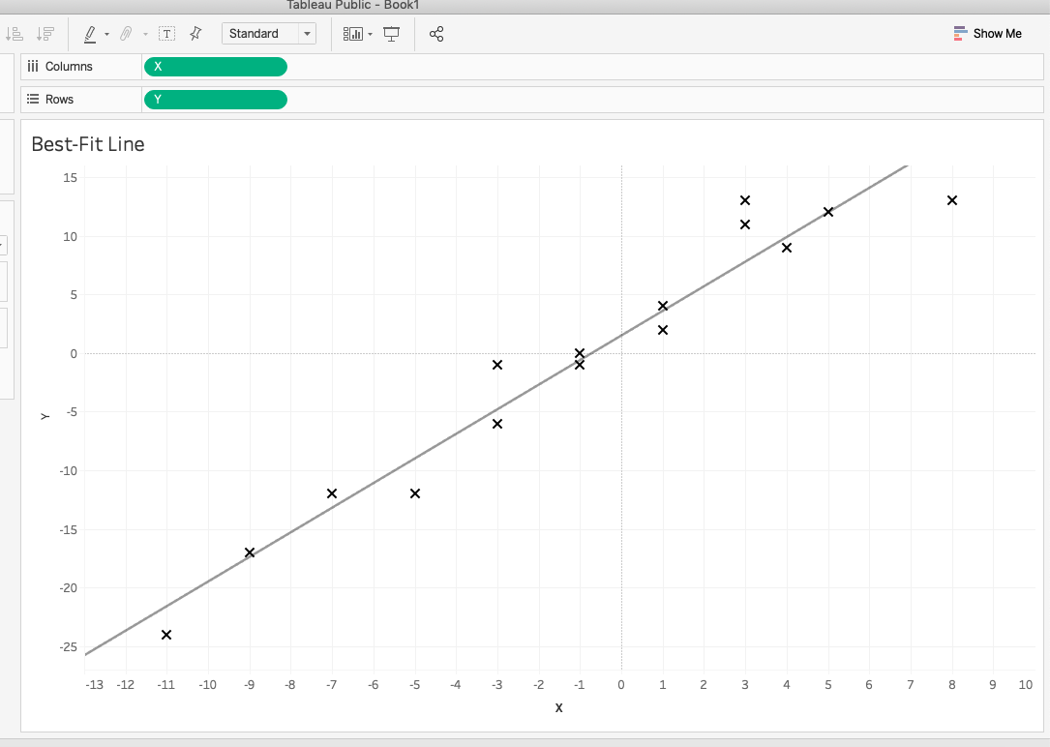
.Best-Fit Line
Notes:
Even though no line will perfectly pass through all of our data points, nevertheless there is still a line that fits the data points best. (This example from Tableau.)

Slide 7


.A Line as a Model.
A Lineas a Model
Predictions for all values of the X variable
Model shape:
Error as the distance between real and
predicted values:
Notes:
The line we construct IS the model, and that means that we’ll have a prediction of our dependent variable (y) for any value of our independent variable (x). Students may not have seen this linear equation with betas, but they’ve likely seen “y = mx + b”, which is different only notationally.
How do we measure the quality of fit of one of these linear models? By calculating its error: the difference between real and predicted values. We don’t want misses above the mark to cancel out misses below the mark, so in general we’ll consider the squares of these differences. Hence: regression by “least squares”.

Slide 8
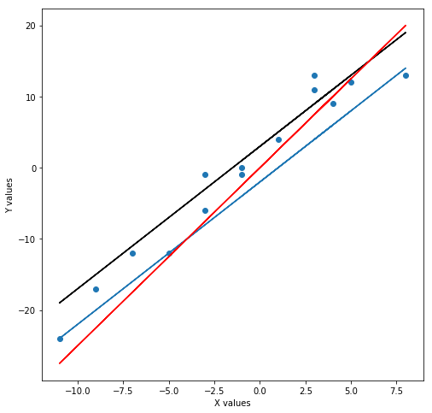
.Goal: Minimize Error
Which of these lines fits the data best?
Notes:
If you pose this question to the students many will say that the black line is best. Some will vote for the red; the blue is pretty clearly inferior to the others. For the record the black is not the best-fit line either, but it is arguably the best of these three. Different votes make for a good occasion to remind students that we can’t just rely on our eyeballs for this!

Slide 9
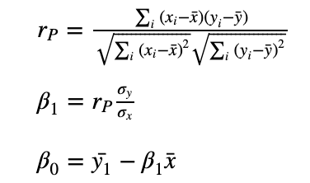

How to Construct the Best-Fit Line
Notes:
It turns out, in fact, that we can express the best-fit line precisely in mathematical equations. If we calculate the Pearson coefficient first (“r_P”), then we can use that to solve for beta_1, which we can then use to find beta_0. Note that these standard deviations are population standard deviations and so should have the full number of data points (n, rather than n-1) in their denominators.

Slide 10
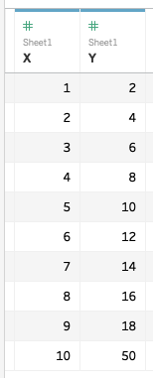
Outliers
Notes:
One note before the LR-by-hand challenge: Outliers can make a VERY large difference to the best-fit line. What do students notice about the data above? Perfect linear relationship between X and Y right up to the last point, where the Y value is suddenly 5 times the X value instead of just twice.
Outliers can happen for many reasons (including things like data-entry error), and there are many techniques for dealing with them.

Slide 11
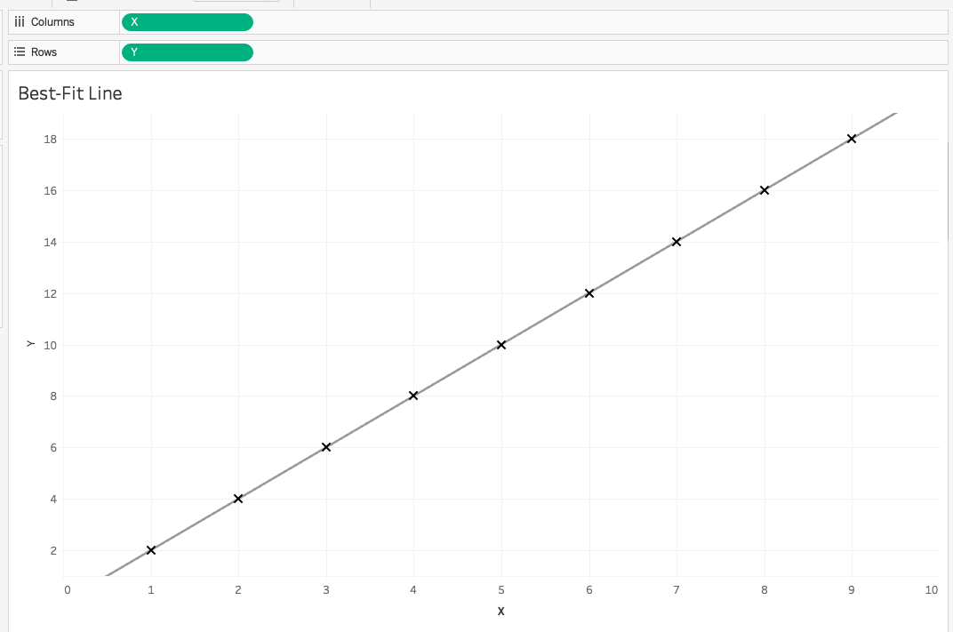
Dropping Outliers
Notes:
If we drop it altogether, then of course we have a perfect model! But the outlier may be an important data point.

Slide 12
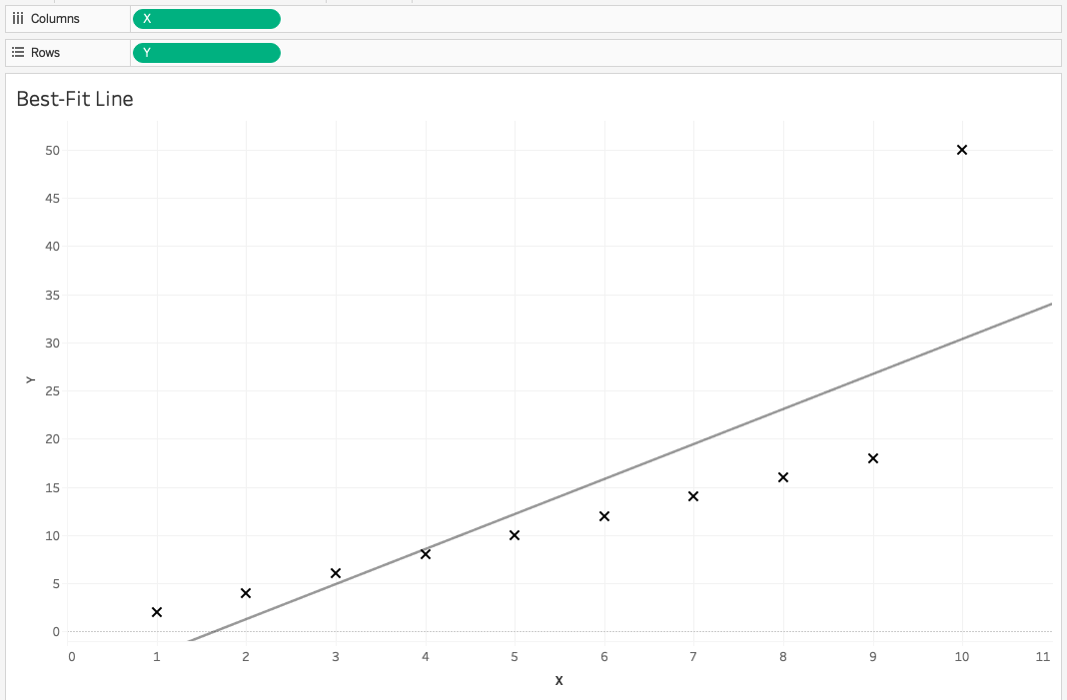
Keeping Outliers
Notes:
You might think that the outlier wouldn’t make any difference to the best-fit line if we included it. After all, the first line would make for zero error for the first nine data points! But because we are dealing with squared distances, the final point (10, 50) makes a very significant contribution to the parameters of the best-fit line.

Slide 13
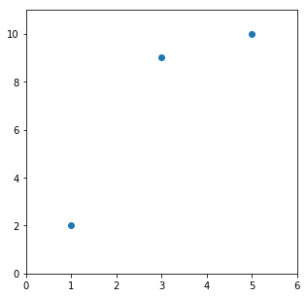
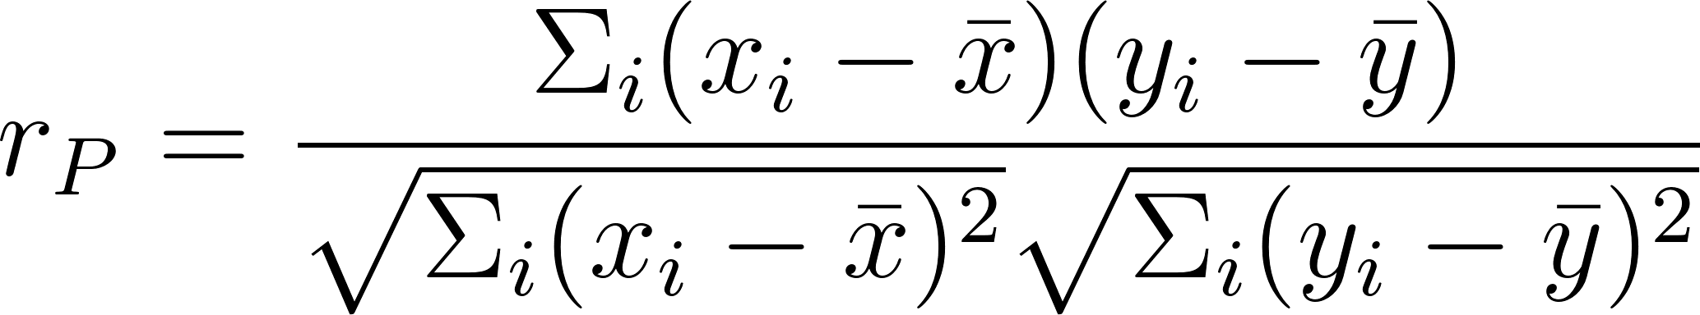
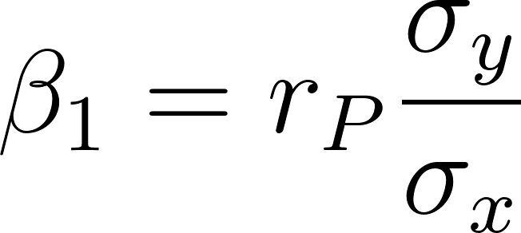
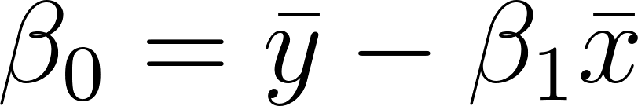
Example
Construct the best-fit line for the points:
(1, 2), (3, 9), and (5, 10).
Remember:
Notes:
Here’s the challenge. Good luck!

Slide 14
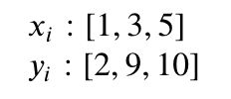
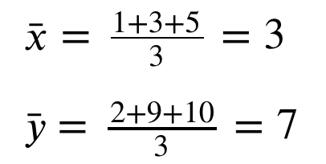
Step 1
Calculate x_bar and y_bar:

Slide 15
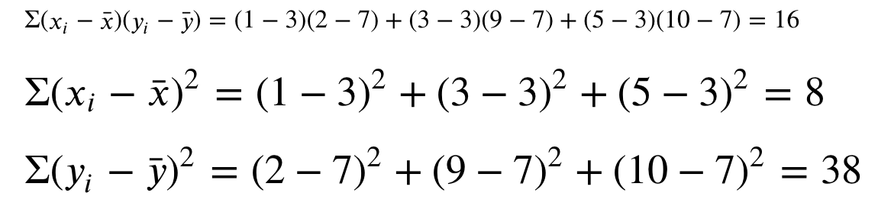
Step 2
Calculate these products:

Slide 16
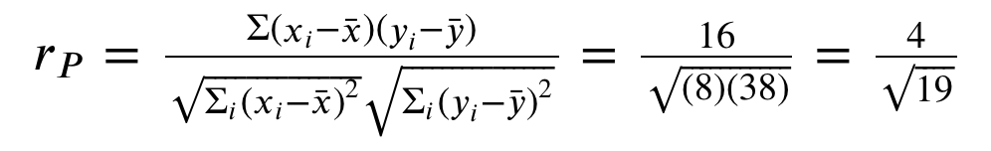
Step 3
Calculate Pearson correlation:

Slide 17
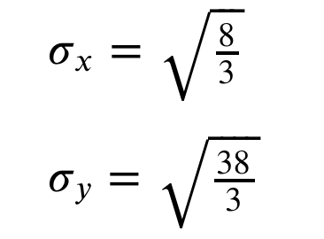
Step 4
Calculate standard deviations:

Slide 18
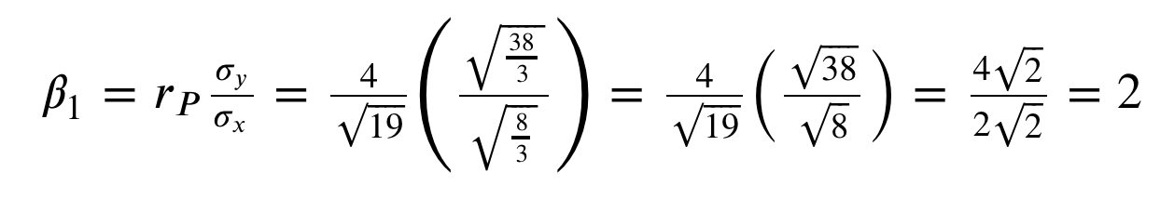
Step 5
Calculate the slope:

Slide 19

Step 6
Calculate the y-intercept:

Slide 20
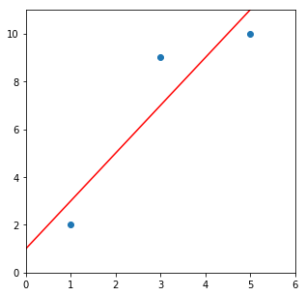

Line
We have our line!
Notes:
The calculation is arduous. (Don’t worry if you didn’t get it!) And this was just for one independent variable and three observations! The code we run to build LRs will be very simple (with the right libraries / tools), but there’s already a lot going on under the hood of these specialized functions. Notice that we can easily calculate the SSE here:
(2-3)^2 + (9-7)^2 + (10-11)^2 = 6.
And what this calculation means is that no line could produce an error smaller than 6.

Slide 21
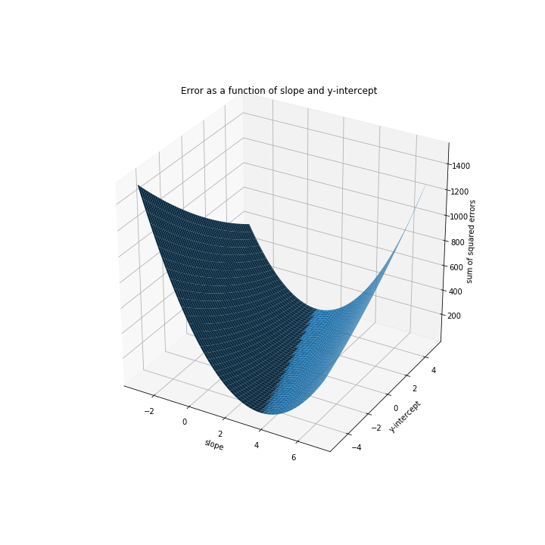
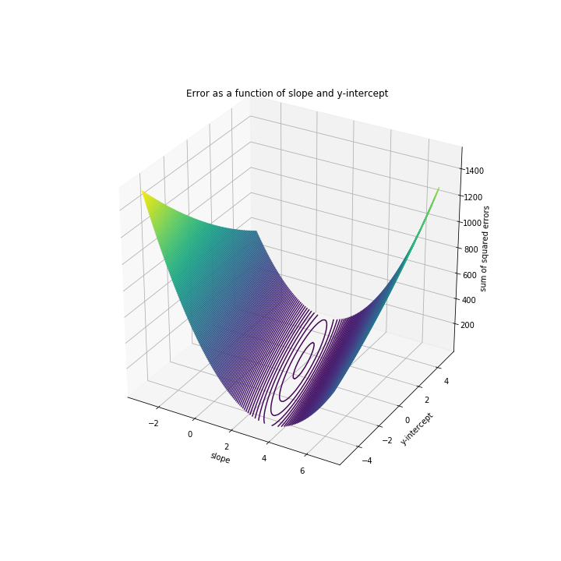
Surface and Contour Plots of SSE(m, b)
Notes:
We can imagine plotting this error as a function of the values of our parameters. Note that, for slope = 2 and y-intercept = 1, the error curve achieves its minimum of 6. This is probably more easily seen on the contour plot.

